Slide 1
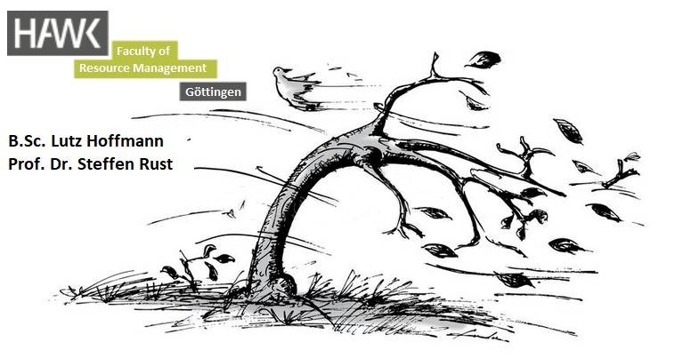
The use of time-localized spectral evaluations to investigate the motion data of heavily damped trees in the wind

Slide 2
Content
Introduction
  the problem using a SDOF-swaying model
  System analysis, Spectral power of wind and pure signal analysis
  Fourier Transform: Relation between amplidude and duration in a spectral representation
Materials and Methodes
  3 trees
  Masurment device (TMS)
  Fourier analysis, Fourier synthesis, wavelet transform
Results and Discussions
  Common Ash
  European Beech
  Hybrid Black Poplar

Slide 3
Introduction

Slide 4
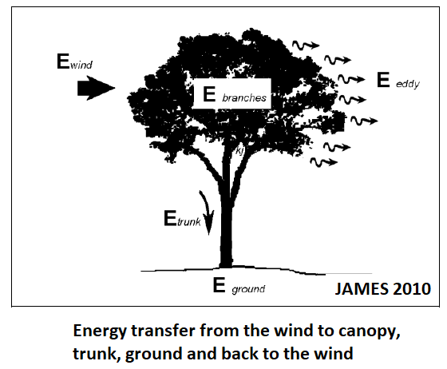
Introduction wind & trees dynamic interaction of trunk and branches

Slide 5
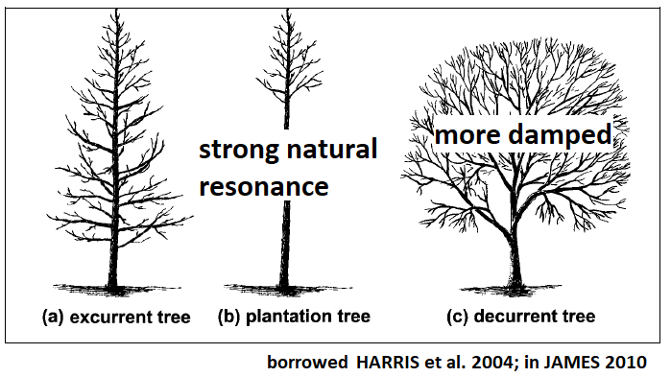
Introduction wind & trees dynamic interaction of trunk and branches

Slide 6
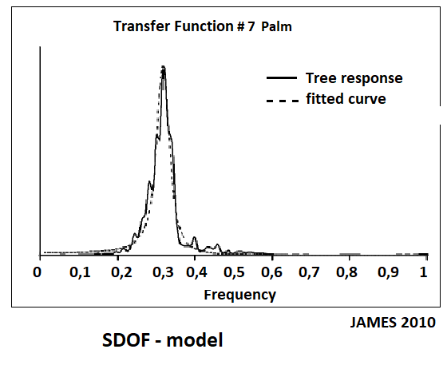
Introduction wind & trees
1. using a SDOF - model

Slide 7
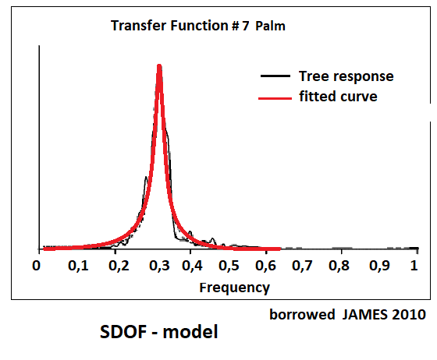
Introduction wind & trees
1. using a SDOF - model

Slide 8
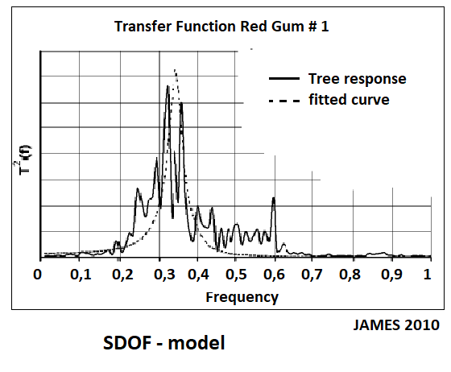
Introduction wind & trees
1. using a SDOF - model

Slide 9
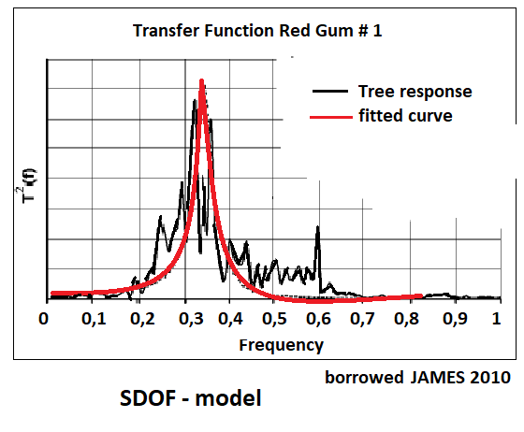
Introduction wind & trees
1. using a SDOF - model

Slide 10
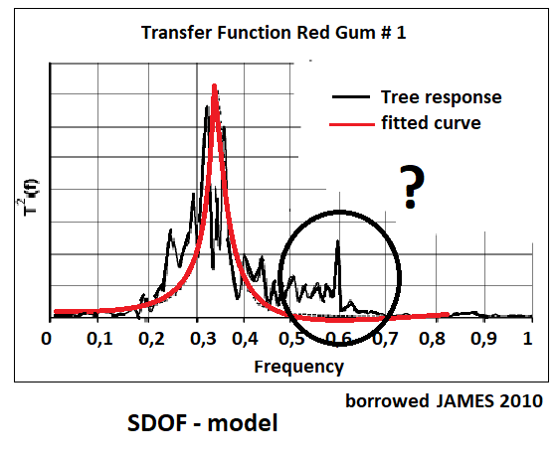
Introduction wind & trees
1. using a SDOF - model

Slide 11
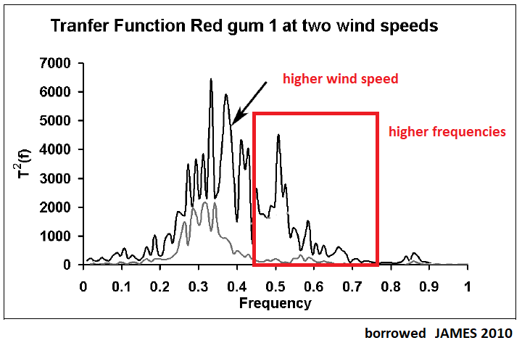
Introduction wind & trees
1. using a SDOF - model

Slide 12
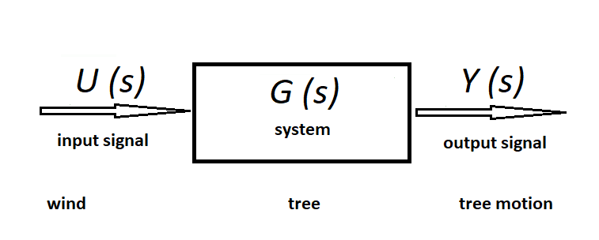
Introduction wind & trees
3. system analysis

Slide 13
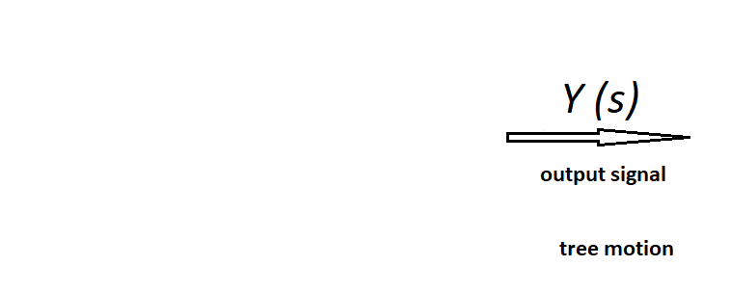
Introduction wind & trees
3. signal analysis

Slide 14
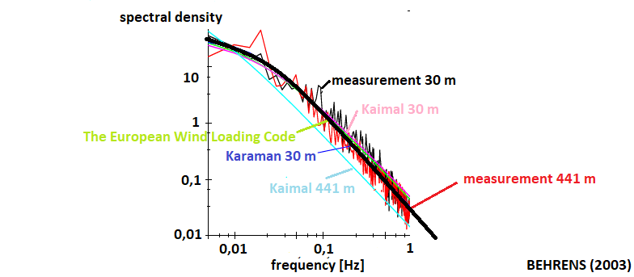
Introduction wind & trees power spectrum of wind

Slide 15
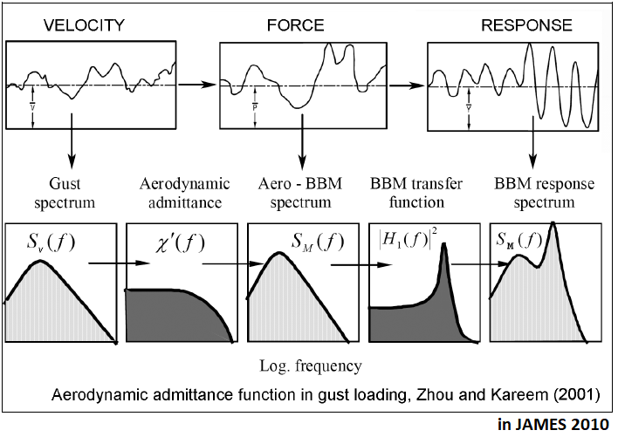
Introduction wind & trees transfer functions

Slide 16
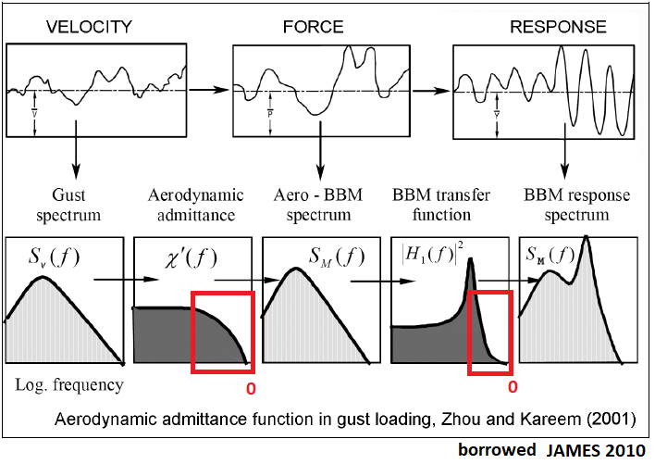
Introduction wind & trees transfer functions

Slide 17
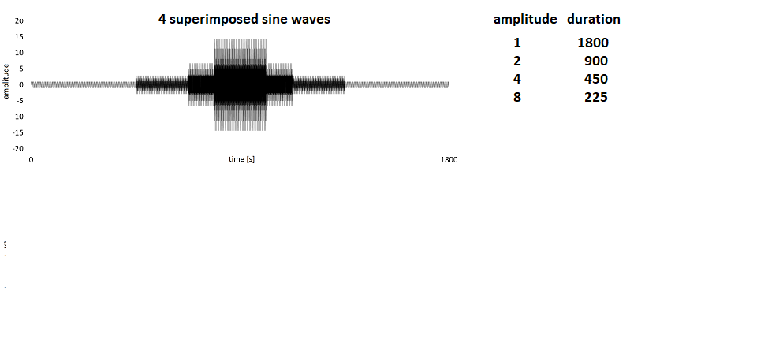
Introduction
Fourier transform
2. characteristic

Slide 18
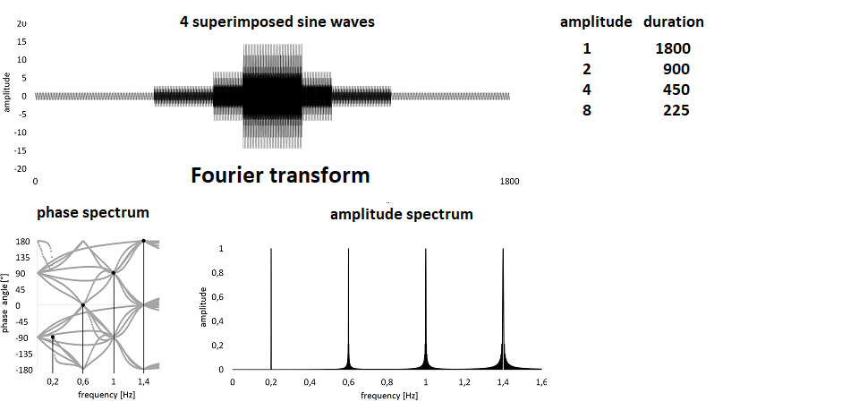
Introduction
Fourier transform
2. characteristic

Slide 19
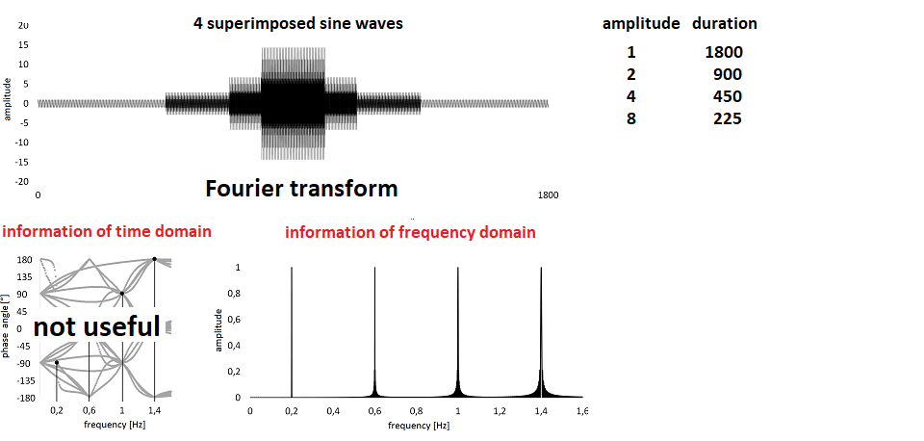
Introduction
Fourier transform characteristic

Slide 20
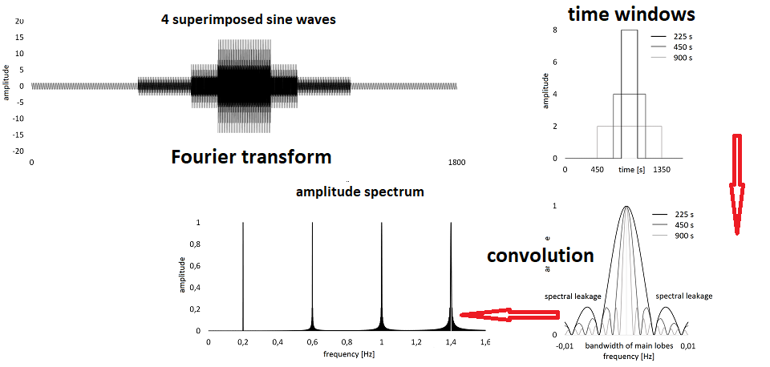
Introduction
Fourier transform characteristic

Slide 21
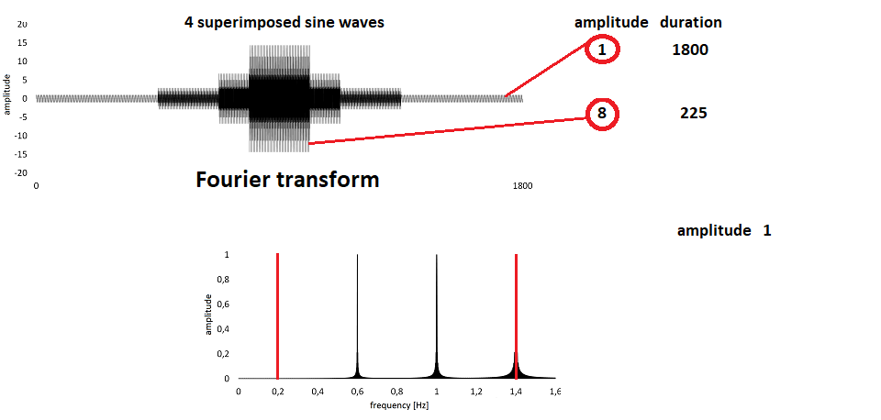
Introduction
Fourier transform characteristic

Slide 22
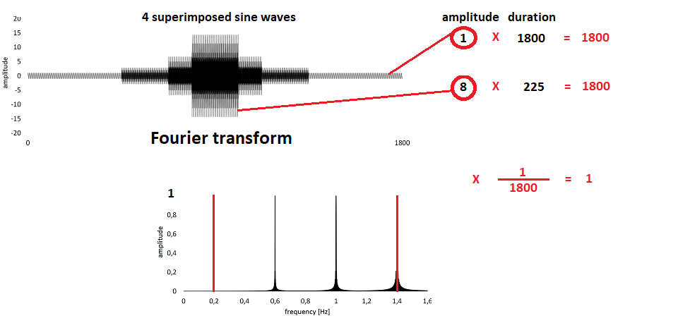
Introduction
Fourier transform characteristic

Slide 23
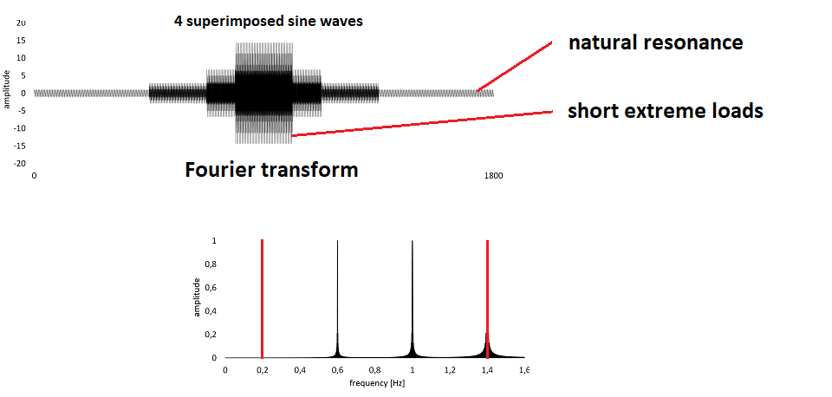
Introduction
Fourier transform characteristic

Slide 24
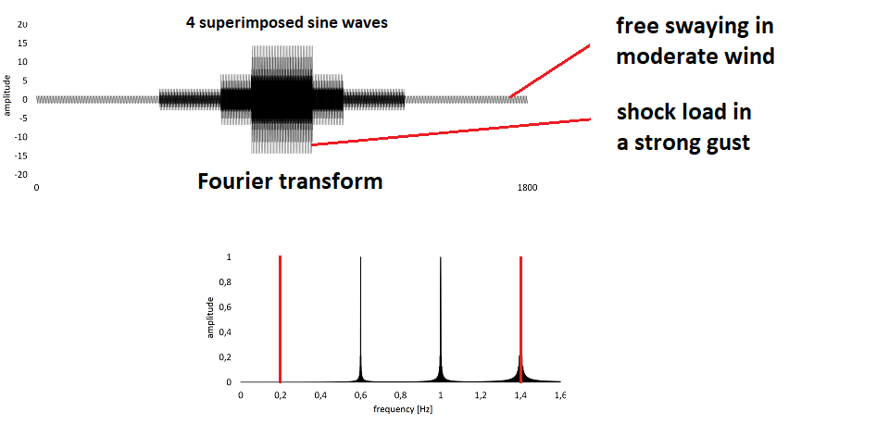
Introduction
Fourier transform characteristic

Slide 25
Materials & Methods

Slide 26
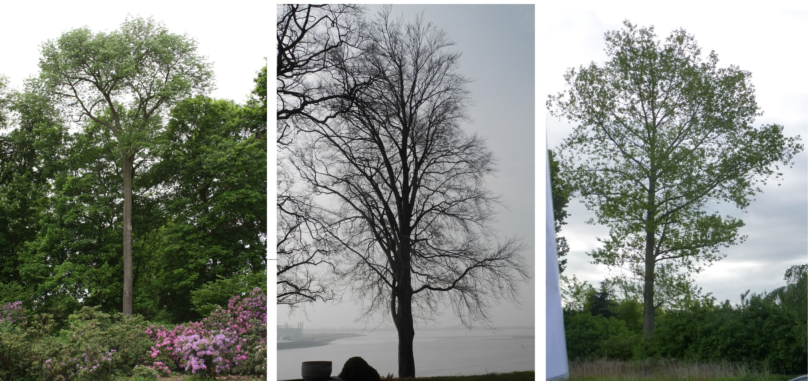
Materials and Methods wind & trees trees

Slide 27
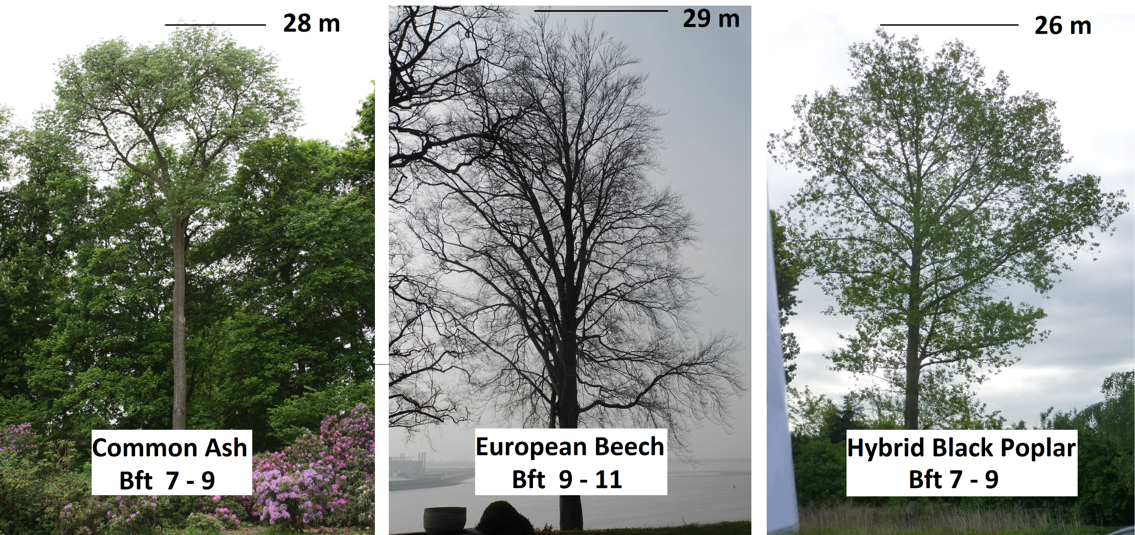
Materials and Methods wind & trees trees

Slide 28
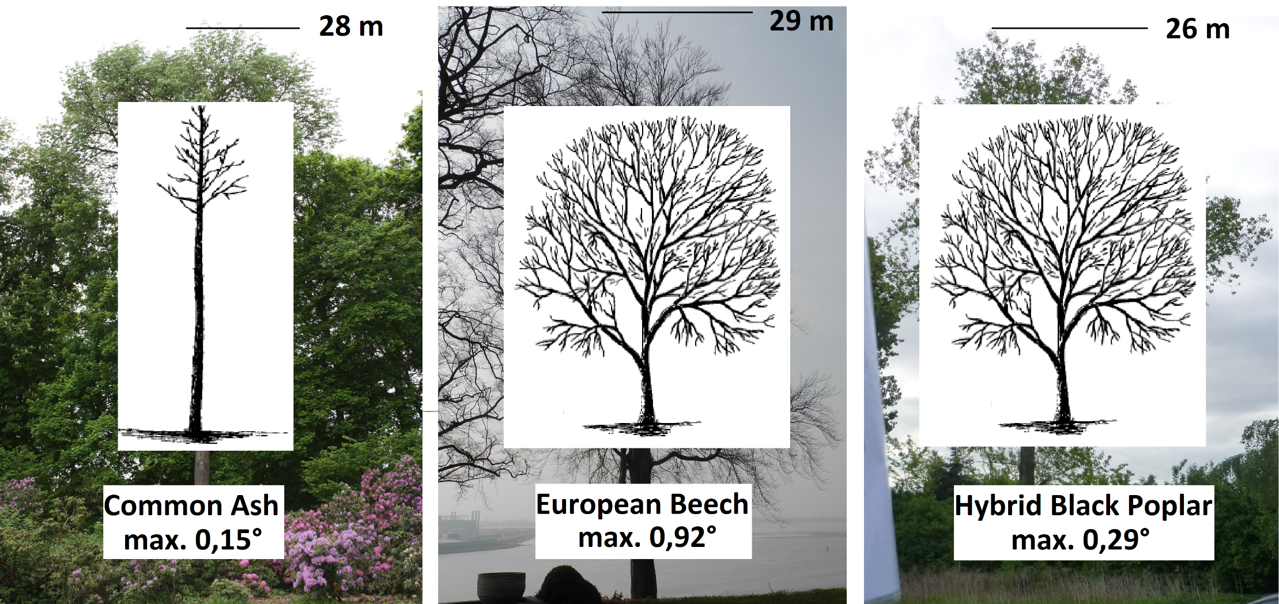
Materials and Methods wind & trees trees

Slide 29
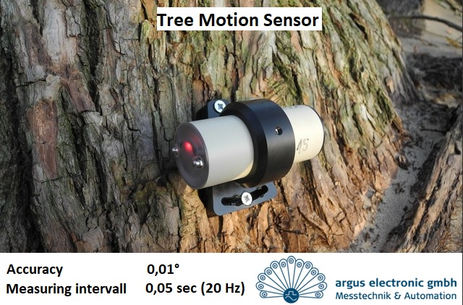
Materials and Methods wind & trees measuring tool

Slide 30
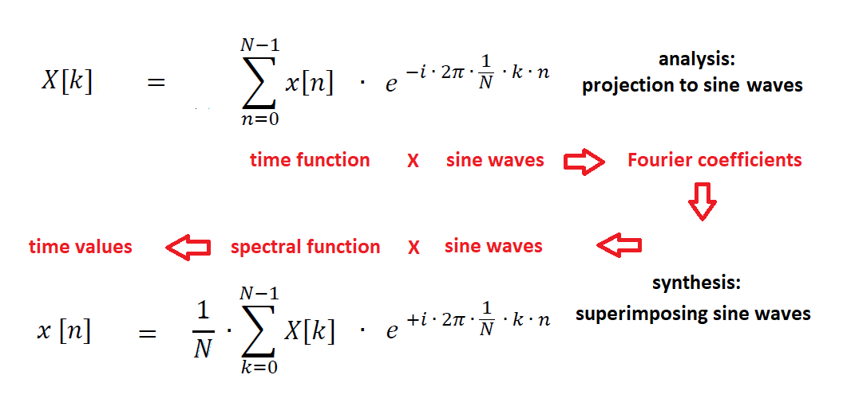
Materials and Methods
Fourier transform basics

Slide 31
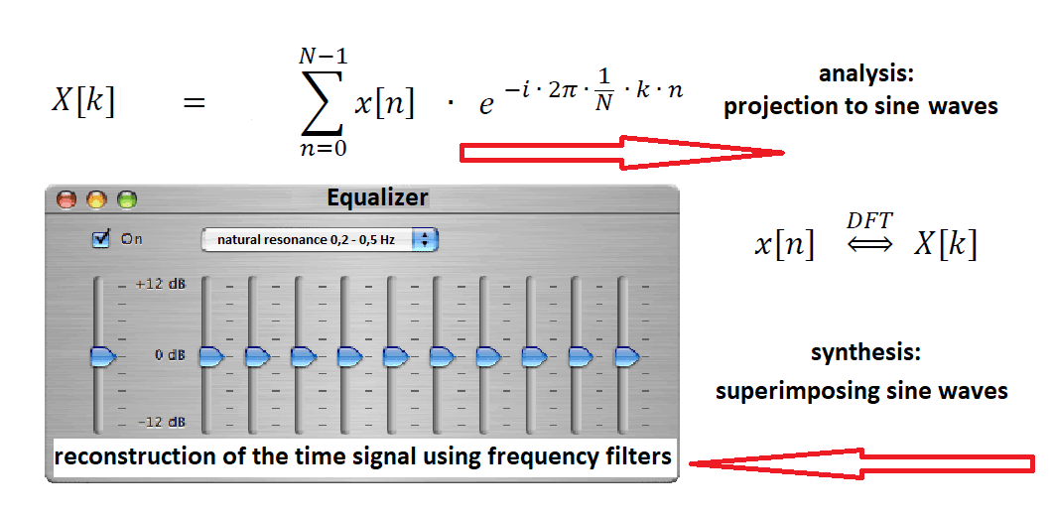
Materials and Methods
Fourier transform basics

Slide 32
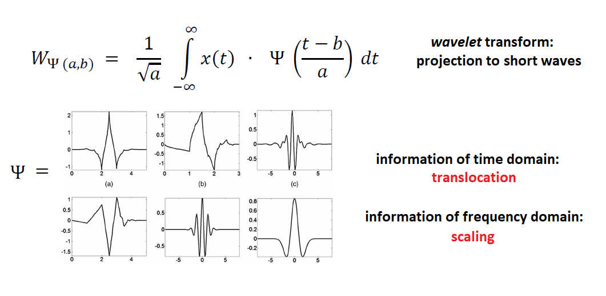
Materials and Methods wavelet transform basics

Slide 33
Results & Discussion

Slide 34
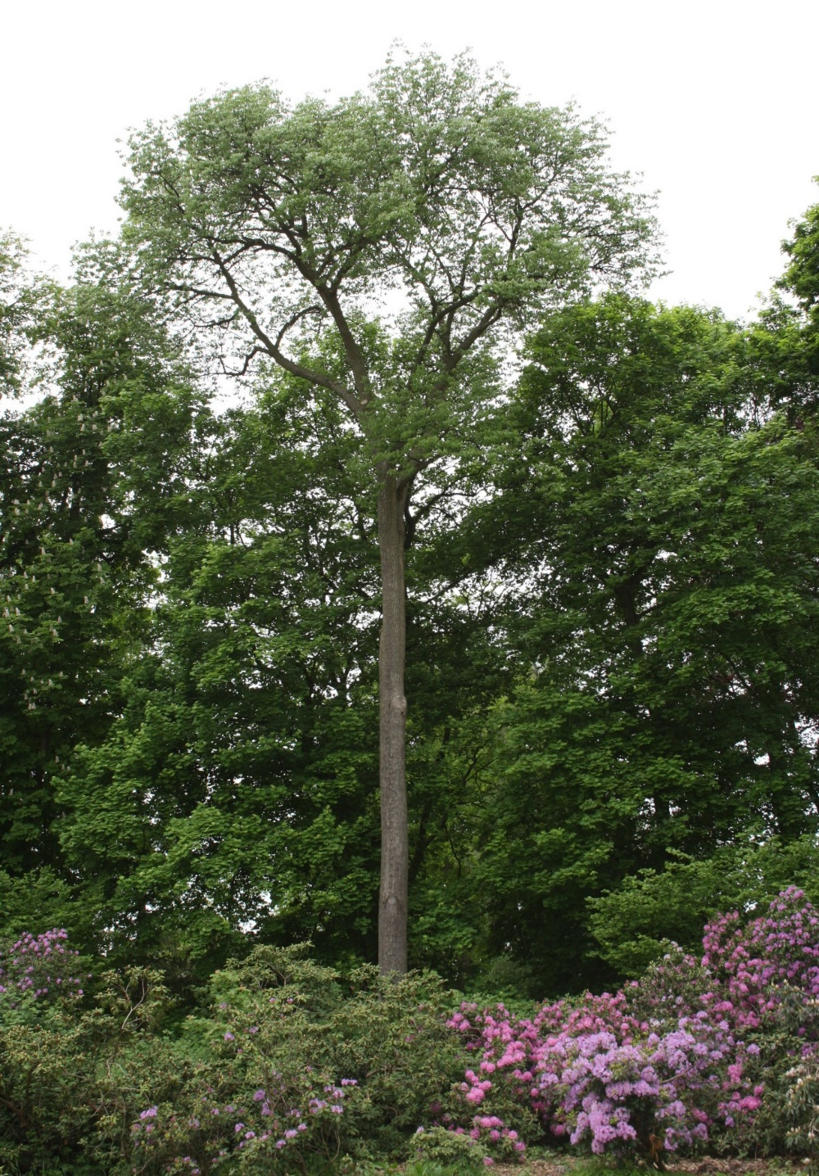
Common Ash

Slide 35
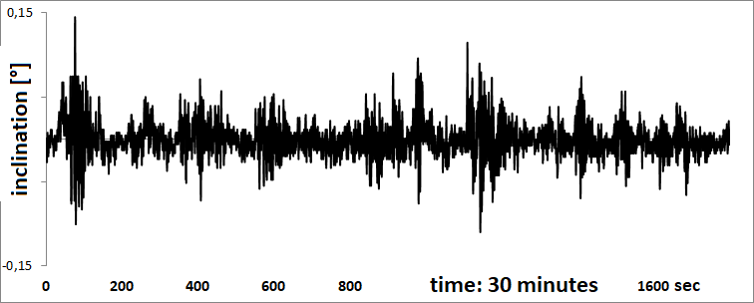
Common Ash time function original time signal 30 minutes

Slide 36
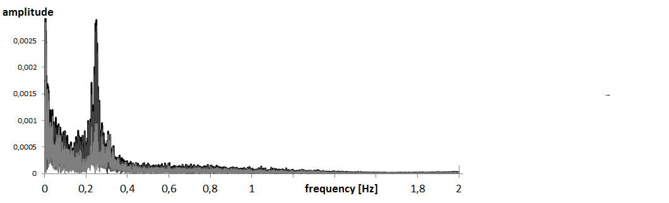
Common Ash
Fourier analysis spectral representation of 30 minutes

Slide 37
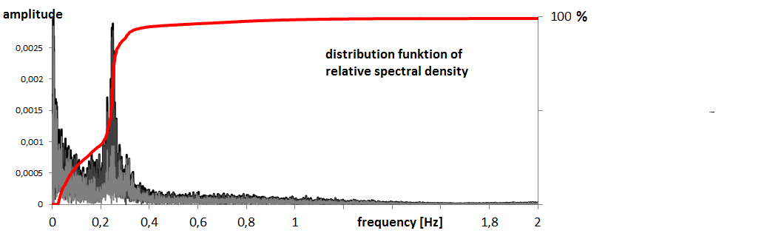
Common Ash
Fourier analysis distribution function

Slide 38
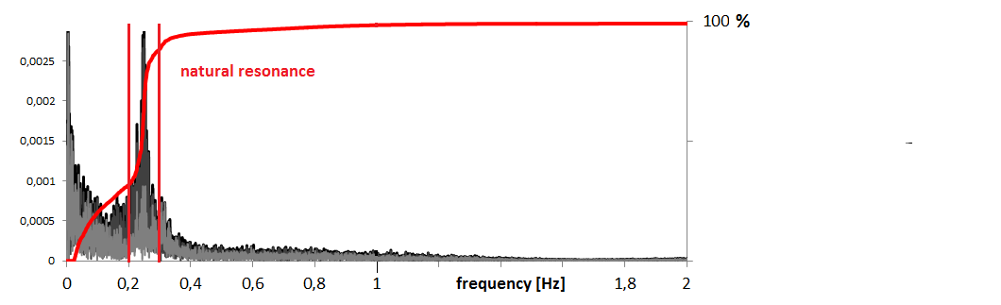
Common Ash
Fourier analysis natural resonance

Slide 39
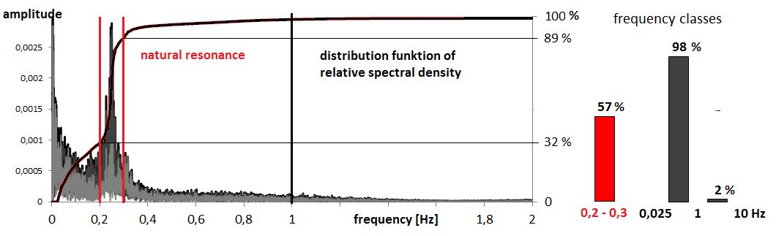
Common Ash
Fourier analysis frequency classes

Slide 40
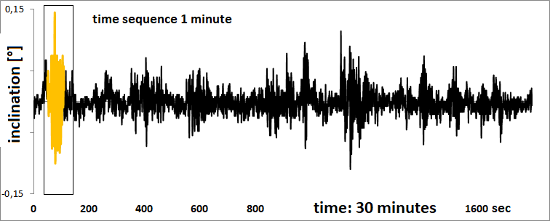
Common Ash
Fourier synthesis reconstruction 1 minute

Slide 41
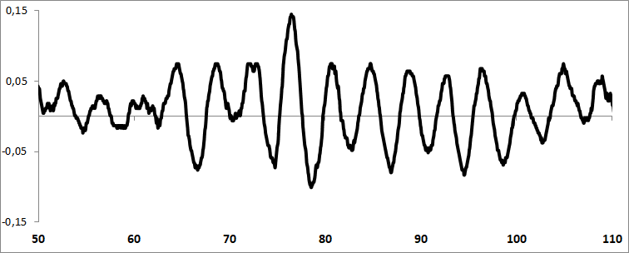
Common Ash time sequence from second 50 to 110, x-axis original time signal 60 seconds

Slide 42
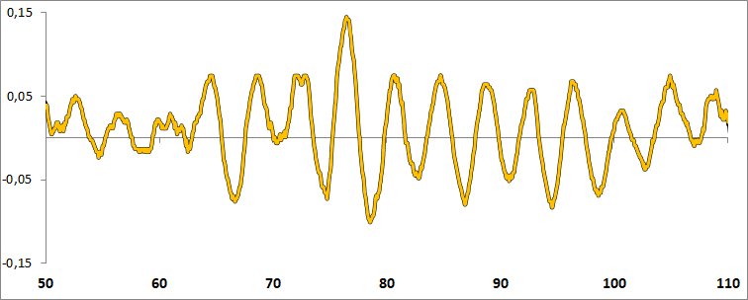
Common Ash
Fourier synthesis total reconstruction

Slide 43
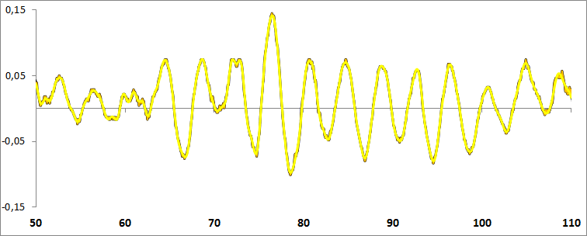
Common Ash
Fourier synthesis reconstruction 0 – 1 Hz

Slide 44
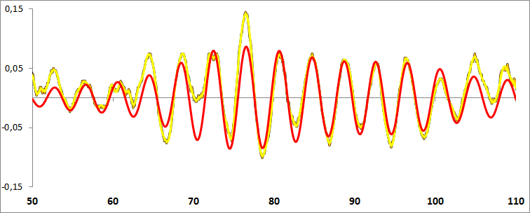
Common Ash
Fourier synthesis reconstruction natrural resonance 0,2 – 0,3 Hz

Slide 45
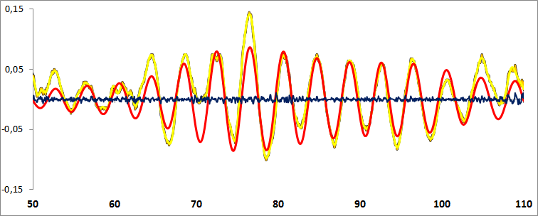
Common Ash
Fourier synthesis reconstruction 1 – 10 Hz

Slide 46
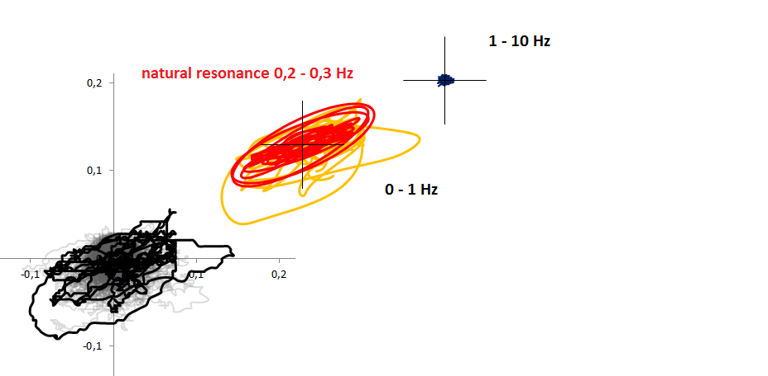
Common Ash
Fourier synthesis polar representation x- and y-axis

Slide 47
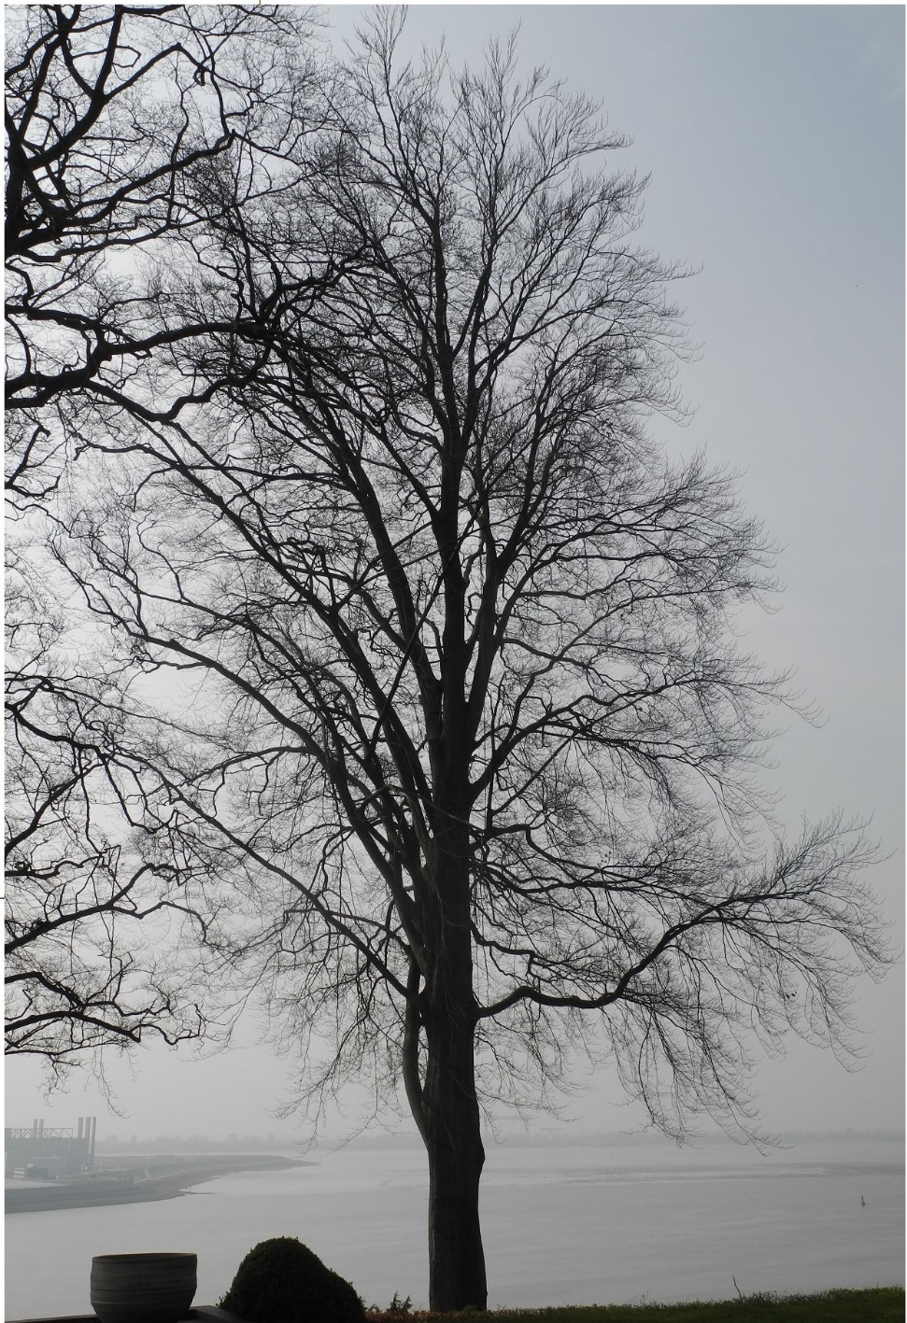
European Beech

Slide 48
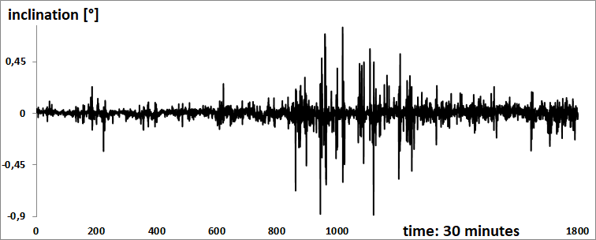
European Beech time function original time signal 30 minutes

Slide 49
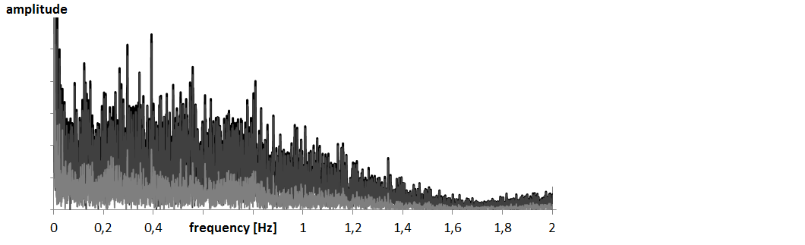
European Beech
Fourier analysis spectral representation of 30 minutes

Slide 50
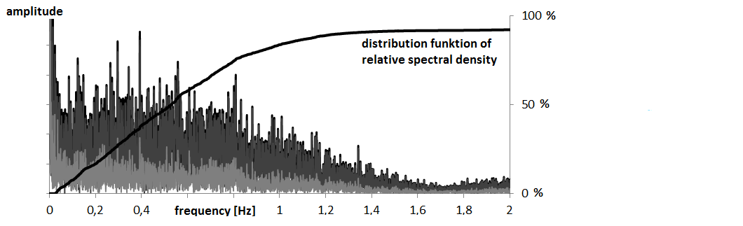
European Beech spectral function, Fourier analysis distribution function

Slide 51
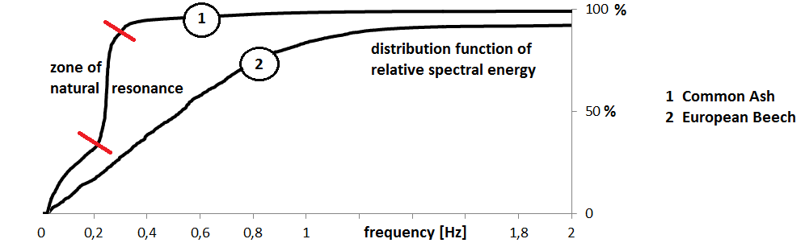
European Beech comparision
Common Ash --- European Beech

Slide 52
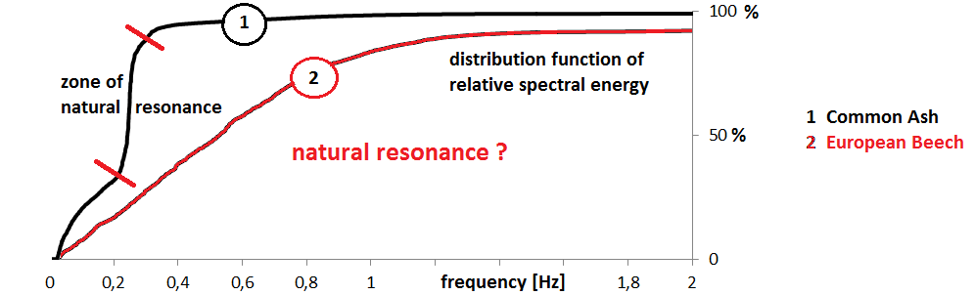
European Beech comparision
Common Ash --- European Beech

Slide 53
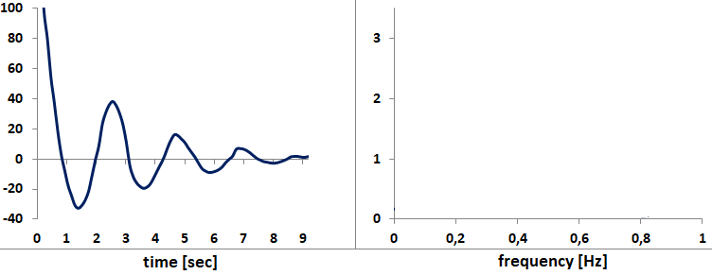
European Beech pull and release test estimation of natural resonance

Slide 54
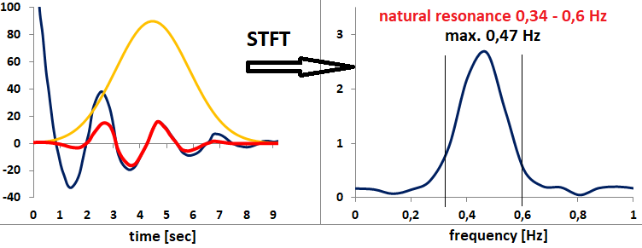
European Beech short time Fourier analysis estimation of natural resonance

Slide 55

European Beech spectral function, Fourier analysis frequency classes

Slide 56

European Beech spectral function, Fourier analysis frequency classes

Slide 57

European Beech
Fourier synthesis original time signal 30 minutes

Slide 58

European Beech
Fourier synthesis total reconstruction 4 minutes

Slide 59

European Beech
Fourier synthesis reconstruction natural resonance 0,34 – 0,6 Hz

Slide 60

European Beech
Fourier synthesis reconstruction 2 short sequences of 10 seconds

Slide 61

European Beech
Fourier synthesis reconstruction 2 short sequences of 10 seconds

Slide 62

European Beech
Fourier synthesis reconstruction 2 short sequences of 10 seconds

Slide 63

European Beech
Fourier synthesis reconstruction 2. sequence

Slide 64

European Beech time sequence from second 1015 to 1025, x-axis original time signal 10 seconds

Slide 65

European Beech
Fourier synthesis total reconstruction

Slide 66

European Beech
Fourier synthesis reconstruction 0,0 – 1,0 Hz

Slide 67

European Beech
Fourier synthesis reconstruction of natural resonance (0,34 – 0,60 Hz)

Slide 68

European Beech
Fourier synthesis reconstruction 1,0 – 10 Hz

Slide 69

European Beech wavelet transform
0,0 – 5,0 Hz

Slide 70

European Beech wavelet transform & Fourier transform
0,0 – 5,0 Hz (10,0 Hz)

Slide 71

European Beech wavelet transform & Fourier transform natrural resonance 0,34 – 0,6 Hz

Slide 72

European Beech
Fourier synthesis polar representation

Slide 73

European Beech
Fourier synthesis reconstruction 1. sequence

Slide 74

European Beech time sequence from second 956 to 966, x-axis original time signal 10 seconds

Slide 75

European Beech
Fourier synthesis total reconstruction

Slide 76

European Beech
Fourier synthesis reconstruction 0,0 – 1,0 Hz

Slide 77

European Beech
Fourier synthesis reconstruction natural resonance (0,34 – 0,60 Hz)

Slide 78

European Beech
Fourier synthesis reconstruction 1,0 – 10 Hz

Slide 79

European Beech wavelet transform reconstruction 0,0 – 5,0 Hz

Slide 80

European Beech wavelet transform & fourier synthesis reconstruction 0 – 1 , 1 – 10 Hz

Slide 81

European Beech
Fourier synthesis reconstruction 3 frequency bands, polar representation

Slide 82

European Beech comparison reconstruction 3 frequency bands, polar representation

Slide 83

European Beech comparison
10 seconds - 30 minutes

Slide 84

European Beech comparison reconstruction 3 frequency bands, polar representation

Slide 85

Hybrid Black Poplar

Slide 86

Hybrid Black Poplar time function original time signal 30 minutes

Slide 87

Hybrid Black Poplar
Fourier analysis frequency classes

Slide 88

Hybrid Black Poplar comparision
Common Ash - European Beech – Hybrid Black Poplar

Slide 89

Hybrid Black Poplar
Fourier synthesis time sequence 10 seconds

Slide 90

Hybrid Black Poplar
Fourier synthesis reconstruction natural resonance 0,3 – 0,5 Hz

Slide 91

Hybrid Black Poplar
Fourier synthesis reconstruction 1 – 10 Hz

Slide 92

Hybrid Black Poplar wavelet transform
0,0 – 5,0 Hz

Slide 93

Hybrid Black Poplar wavelet transform & Fourier synthesis reconstruction 0 -1 / 1 -10 / natural resonance 0,3 – 0,5 Hz

Slide 94

Hybrid Black Poplar
Fourier synthesis polar representation x- and y-axis

Slide 95

Hybrid Black Poplar
Fourier synthesis polar representation x- and y-axis

Slide 96


Slide 97
Resources
BEHRENS, M.; 2003: Aerodynamische Admittanzansätze zur Böenwirkung auf hohe, schlanke Bauwerke. Dissertation am Fachbereich Bauingenieurwesen der Technischen Universität Carolo-Wilhelmina zu Braunschweig.
FOLLETT, M.; 2016: 11. SAG Workshop 09. Mai 2016 in Gautingen, Messungen im natürlichen Wind, Ein-satzmöglichkeiten für die Beurteilung der Verkehrssicherheit. Auswirkung von Asteinkürzungen auf die Dynamik in der Krone.
JAMES, K.R.; 2010: A Dynamic Structural Analysis of Trees Subject To Wind Loading. Ph.D. thesis. Uni-versity of Melbourne.
MOULIA B.; 2016: The dynamics of trees in wind: compartmentalization of mechanical energy and tree safety; 12th SAG Workshop on 4.10.2016 in Nancy, France
RODRIGUEZ, M., DE LANGRE, M., MOULIA, B.; 2008: A scaling law for the effects of architecture and allom-etry on tree vibration modes suggests a biological tuning to modal compartimentalisation. American Journal of Botany 95(12): 1523–1537. 2008.
Software:
LUNGU, G.; 2013: www.excelunusual.com; discret Fourier analysis in Excel; Colorado
VALLEN GmbH: www.vallen.de/downloads; Wavelet freeware-programm, Vallen GmbH, Icking, Germany

